Slide 1
„Road Casualty-Assistance Germany“ „German Federation of Road Traffic Victims“ “Registered association“ - charitable tax-exempt status -
E-Mail: info@verkehrsunfall-opferhilfe-deutschland.com
web: www.verkehrsunfall-opferhilfe-deutschland.com
Anschrift: Zum Roten Berge 18-24
48165 Münster
Telefon: 02501/806 305

Slide 3
Introduction
Wulf Hoffmann
Member of the board VOD
Former Head of Road / Traffic Policing, Ministry of the Interior Saxony-Anhalt
TISPOL WG Road Policing (2012)
Retired 2012
Advisor commission „Road Safety“ (DPolG - Police Union)
Memer of board committee „Traffic engineering“ (DVR - German Road Savety Council)
Vice president „Landesverkehrswacht“ Saxony-Anhalt
German Road Safety Association
With Associations for Road Safety in each German federal state (land)
About 630 regional, district and local clubs (26 in Saxony-Anhalt)
Notes:
42 years at the police, predominant in the field of the police traffic tasks
traffic enforcement
traffic accident sevice
subject teacher among others traffic law
Head of investigation service among others for traffic criminal offences
Chair fore accident commission
since 2002 head of police traffic matters in Saxony- Anhalt

Slide 4
Projects DVW
Projects for our main target groups are funded by the Federal Ministry of Transport and Digital Infrastructure
are
Mobil bleiben, aber sicher! (the elderly)
FahrRad…aber sicher! (cyclists)
Kinder im Straßenverkehr (preschool children)
Aktion junge Fahrer (novice and young drivers)
Within Saxony-Anhalt
Schulwegsicherheit (road safety on the way to school)
Verkehrsteilnehmerschulung (every road user)

Slide 6
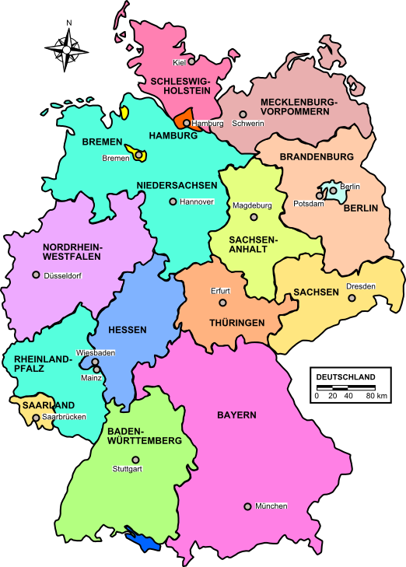
Germany and it‘s Federal States
Federal Government
Federal Ministry of Interior (Federal Police Border-Air-Rail)
Federal Ministry of Transport
16 Federal States
with their own
16 Governments
16 Ministry of Interior
16 Independent Police Forces
Notes:
6
16 governments of the federals States
the roadworthiness work has to be coordinated for 16 Home Offices,
16 Ministries of Transport and
16 Ministries of Justice
as well as 16 Ministries of Education and the Arts (traffic prevention)

Slide 7
Umbrella Association
German Umbrella Association for all regional victims institution / organisations.
Founded 2011
Prof. Dr. W. Echterhof, Institut für Psychologische Unfallnachsorge (ipu), Köln
Psychological after-care Institute , Colone
Senior police officers from several Federal Staates of germany
German Police University
Charitable tax-exempt status 2012
Registered association 2013
Academic advisory council 2014

Slide 8
Members 2014
Deutsche Gesellschaft für Verkehrspsychologie e.V.
Deutsche Hochschule der Polizei (DHPol)
Deutsche Kinderhilfe e.V.
Deutsche Polizeigewerkschaft (DPolG)
Deutsche Verkehrswacht e.V. (DVW)
Gesellschaft für Ursachenforschung bei Verkehrsunfällen e. V. (GUVU)
Institut für Psychologische Unfallnachsorge in Köln (ipu)
Unfallopfer-Lobby Deutschland subvenio e.V

Slide 9
Cooperation 2014
Bundesanstalt für Straßenwesen (BASt)
Deutscher Verkehrssicherheitsrat e. V. (DVR)
Fédération Européenne des Victimes de la Route (FEVR)
World Health Organisation (WHO)
ZNS - Hannelore Kohl Stiftung

Slide 10
Concret Consideration 2014
Aktion Kinder-Unfallhilfe eV – KRAVAG Versicherung
Bund gegen Alkohol und Drogen im Straßenverkehr e.V. (BADS)
Björn Steiger Stiftung
Deutsche Gesellschaft für Verkehrsmedizin e.V. (DGVM)
Evangelische Notfallseelsorge in der EKD
Fachhochschule für öffentliche Verwaltung NRW (FHöV NRW)
Fachverband Psychologie für Arbeitssicherheit und Gesundheit e.V. (FV PASiG)
Gewerkschaft der Polizei (GdP)

Slide 11
Intention / Targets
National and International network
Umbrella function for Members
Lobbying
Voice for road accident victims
Supporting road safety work in Germany
Workshop in October

